Slide 1

MINOR PROJECT EVALUATION · 2026
AI-Powered Student
Management System
CornerStone — Smart Education ERP · Full-stack web application with ML-based performance prediction
TEAM MEMBERS
Gaurav Ranpeeshiya — BTIT24O1055
Khushbu Raout — BTIT241069
BRANCH / SECTION
B.Tech (IT)
FACULTY MENTOR
[Faculty Mentor Name]
INSTITUTE
Madhav Institute of Technology and Science, Gwalior · Deemed University
Flask REST API · scikit-learn Random Forest · SQLite / SQLAlchemy · Docker + Nginx

Slide 2
AGENDA
What we will cover
A structured walkthrough — focus on work completed so far
01
Introduction
08
Technologies & Tools
02
Problem Statement
09
Project Progress / Work Completed
03
Objectives
10
Team & Individual Contributions
04
Literature Review / Existing System
11
Work Plan / Timeline
05
Proposed System
12
Expected Outcomes
06
Methodology & System Architecture
13
References & Next Steps
07
AI Workflow & Pseudocode
Evaluation focus — project background · methodology · individual contributions · progress to date
AI-Powered Student Management System · Minor Project Evaluation
02 / 17

Slide 3

SECTION 01 · INTRODUCTION
Introduction
Project background and overview of the selected domain
▪ Background — Student records are scattered across registers, spreadsheets and separate portals — slow, error-prone and hard to analyse.
▪ Need — Institutes need one unified, automated platform covering the full student lifecycle that turns raw data into insight.
▪ This project — A full-stack, AI-powered Student Management System with role-based portals for Admin, Faculty, Student, Parent and Staff.
▪ AI component — ML models predict performance from attendance, study hours and sleep hours — enabling early intervention and auto-routed support.
DOMAIN OVERVIEW
▪ Domain — Educational Technology — Smart Campus / Education ERP.
▪ Scope — Student info, attendance, finance, certificates, curriculum, GPA, reports and analytics.
▪ Intelligence — Data-driven early-warning with explainable prediction and NL analytics.
▪ End users — Admins, faculty, students, parents, staff — with tailored dashboards.
TAKEAWAY
Record, predict, and act on student performance from one platform.
AI-Powered Student Management System · Minor Project Evaluation
03 / 17

Slide 4
SECTION 02 · PROBLEM
Problem Statement
The challenge being addressed and why it matters
▪ Fragmented records — Attendance, marks and study data live in separate systems — no single source of truth.
▪ No early warning — At-risk students are identified only after results fall — usually too late.
▪ Manual reporting — Reports are prepared by hand — slow, inconsistent and error-prone.
▪ Limited visibility — Parents and faculty have almost no real-time view of behaviour and progress.
▪ No prediction — Existing systems store data but never convert it into predictions or alerts.
MOTIVATION
▪ Student outcomes — Early identification enables timely mentoring and better pass rates.
▪ Efficiency — Automation saves faculty hours spent on registers and reports.
▪ Informed decisions — Dashboards give management a data-backed view.
▪ Engagement — A parent portal keeps families connected to progress.
MOTIVATION
Fixing this directly improves student outcomes and staff productivity.
AI-Powered Student Management System · Minor Project Evaluation
04 / 17

Slide 5
SECTION 03 · OBJECTIVES
Objectives
Major goals and the expected results of the project
▪ Unified management — Single web platform for students, attendance, curriculum, GPA, finance, certificates and calendar.
▪ AI prediction — ML model to predict marks / risk from attendance, study and sleep behaviour.
▪ Explainability — Per-feature impact analysis so every prediction is understandable.
▪ Role-based access — Secure JWT authentication with distinct Admin, Faculty, Student, Parent and Staff experiences.
▪ Analytics & reports — Dashboards plus one-click CSV / Excel / PDF exports and natural-language queries.
▪ Alerts & communication — Notifications, messages and intelligent alerts for early intervention.
EXPECTED OUTCOMES
▪ Early-risk alerts for at-risk students
▪ Automated, consistent reports — no manual work
▪ One unified, searchable student database
▪ Stronger faculty · student · parent collaboration
▪ A reusable, testable, extensible full-stack foundation
AI-Powered Student Management System · Minor Project Evaluation
05 / 17

Slide 6
SECTION 04 · LITERATURE
Literature Review / Existing System
What exists today, and the gap this project fills
▪ Existing systems — Traditional Student Information Systems (ERP modules), LMS platforms such as Moodle, and spreadsheet-based tracking.
▪ Research context — Supervised ML over attendance and study behaviour can predict academic performance.
▪ Reporting tools — Standard ERPs generate operational reports but rarely analyse or predict academic outcomes.
▪ Limitation — None combine record-keeping with an explainable early-warning engine.
IDENTIFIED GAP
▪ Generic ERPs — Record data but never predict or explain outcomes.
▪ No early-warning — At-risk students are not flagged automatically.
▪ Read-only for parents — Weak parent · faculty collaboration channels.
▪ Manual audit — Reporting and audit trails are largely manual.
▪ Our fill — Built-in explainable prediction, risk scoring, and role-based alerting workflows.
AI-Powered Student Management System · Minor Project Evaluation
06 / 17

Slide 7
SECTION 05 · PROPOSED
Proposed System
Our solution, its key features, and expected contribution
▪ Solution — Full-stack web application — Flask REST API + SQLite (SQLAlchemy) + static PWA frontend, with a scikit-learn Random Forest model.
▪ Prediction + explain — Inputs (study, sleep, attendance) → predicted marks, risk level and per-feature impact.
▪ Reporting engine — CSV / XLSX / PDF exports with search, attendance-band and risk filters.
▪ Security & ops — JWT auth, role-based access, rate limiting, caching, audit logs, background jobs, Docker deployment.
KEY FEATURES
Admin / Faculty / Student / Parent / Staff portals
Attendance tracking + analytics
Predict & explain risk (Low / Medium / High)
Finance, certificates, projects & observations
Curriculum, GPA, OBE, timetable, calendar
Grievances · NL analytics · AI routing
Parent portal, meetings, daily summaries
Docker + Nginx deployment, audit, backups
AI-Powered Student Management System · Minor Project Evaluation
07 / 17

Slide 8
SECTION 06 · METHODOLOGY
Methodology & System Architecture
Proposed workflow and the layered system design
PROPOSED WORKFLOW
1. Collect
attendance · study logs
2. Store
SQLite via SQLAlchemy
3. Analyse
Random Forest + risk rules
4. Act
alerts · dashboards · reports
▸
▸
▸
SYSTEM ARCHITECTURE
USERS
Admin · Faculty · Student · Parent · Staff
FLASK REST API (Frontend – PWA: HTML / CSS / JS)
JWT auth · RBAC · rate limiting · TTL cache · Socket.IO · audit logs
SQLITE DATABASE
SQLAlchemy ORM · WAL mode · idempotent migrations (migrate.py)
AI ENGINE
Random Forest Regressor — prediction + feature-impact explanation
AI-Powered Student Management System · Minor Project Evaluation
08 / 17

Slide 9
SECTION 07 · AI WORKFLOW
AI Workflow & Pseudocode
Prediction pipeline, flow diagram, and algorithm behind /predict & /predict/explain
FLOWCHART — PERFORMANCE PREDICTION PIPELINE
PSEUDOCODE — PREDICT + EXPLAIN
START
FUNCTION predict_and_explain(study, sleep, attend):
INPUT: study_hours, sleep_hours, attendance
IF invalid range: RETURN error 400
predicted <- RF_model.predict([study, sleep, attend])
# XAI: per-feature impact vs reference profile
baseline <- RF_model.predict([2.5, 7.5, 80])
FOR feature f IN [study, sleep, attend]:
impact[f] <- RF_model.predict(swap_one(f)) - baseline
SORT impact by |impact| DESC
# Weighted risk score (0-100, clamped)
score <- 0
IF attend < 60: score += 30 ELIF < 75: score += 10
IF study < 2: score += 15 ELIF < 3: score += 5
IF sleep < 5: score += 15 ELIF < 6: score += 5
IF predicted < 60: score += 40 ELIF < 75: score += 20
CLAMP score to [0, 100]
level <- LOW IF score <= 33
level <- MEDIUM IF score <= 66
level <- HIGH otherwise
IF level = HIGH:
ALERT student, faculty, parent
CREATE intervention plan
SAVE metric history
UPDATE dashboard
RETURN {predicted_marks, baseline_marks,
impacts (sorted), risk {score, level}}
Input: study_hours, sleep_hours, attendance
Within valid range?
No
Return 400 error
RandomForest.predict(features)
→ predicted_marks
Explain: impact per feature vs reference
risk_score → level (low / medium / high)
Risk level = high?
Yes
Alert + notify + intervention
No
Save history · update dashboard
END — return {marks, impacts, risk}
Sources: model.py · _risk_score · _xai_impacts
AI-Powered Student Management System · Minor Project Evaluation
09 / 17

Slide 10
SECTION 08 · TECHNOLOGY
Technologies & Tools
Languages, frameworks and tooling used in the build
Area | Tools / Technologies
Programming | Python 3.13, HTML5, CSS3, JavaScript (ES6)
Web framework | Flask, Flask-CORS, Flask-SocketIO, Flask-Mail
AI / ML | scikit-learn (RandomForestRegressor), NumPy
Database | SQLite, SQLAlchemy ORM (+ MySQL connector support)
Auth / Security | PyJWT, Werkzeug hashing, role-based access, rate limiting
Reporting | ReportLab (PDF), OpenPyXL (XLSX), CSV
Frontend / PWA | Static web app with manifest.json & service worker
Deployment / Ops | Docker, Nginx, migrate.py migrations, pytest, TTL caching, backups, Git
WHY THESE
Mature, widely documented stack — quick to build, easy to test, and portable to MySQL / cloud later.
AI-Powered Student Management System · Minor Project Evaluation
10 / 17

Slide 11

SECTION 09 · PROGRESS
Project Progress / Work Completed
What has been built and verified so far
270
9 / 9
5
3
REST API endpoints implemented
automated pytest cases passing
role-based portals · Admin, Faculty, Student, Parent, Staff
core AI engines: predict · explain · risk
▪ Backend API — auth, attendance, GPA/OBE, timetable, calendar, reports.
▪ Enterprise modules — finance, certificates, projects & observations.
▪ AI services — predict/explain/risk, NL analytics, auto-triage.
▪ Ops & security — JWT, RBAC, caching, audit, backups, background jobs.
AUTOMATED TEST SUITE
▪ Auth & token refresh · pagination
▪ RBAC on reports (student → 403)
▪ Student CRUD + attendance flow
▪ Input validation edge cases
▪ Master-data permissions + calendar
▪ GPA / grade flow + curriculum
Run: pytest (pytest.ini) · start.bat → :5000 / :3000
AI-Powered Student Management System · Minor Project Evaluation
11 / 17

Slide 12
SECTION 10 · TEAM
Team & Individual Contributions
Module ownership across the team
Backend API & Security
AI & Explainability
▪ JWT authentication and role-based access
▪ Student / attendance / reporting endpoints
▪ Rate limiting, caching, audit logs, backups
▪ Random Forest prediction model
▪ Risk scoring engine (0–100)
▪ Explain endpoint + alerts / interventions
[Member 1] — [Enrollment No.]
[Member 2] — [Enrollment No.]
Dashboards & Reporting
Frontend Portals
▪ Analytics, insights and search
▪ CSV / XLSX / PDF report exports
▪ Monitoring and background jobs
▪ Student / faculty / parent admin UIs
▪ PWA (manifest + service worker)
▪ Engagement, notifications, messaging
[Member 3] — [Enrollment No.]
[Member 4] — [Enrollment No.]
Tailor module assignments to your actual work — be ready to demonstrate each during evaluation.
AI-Powered Student Management System · Minor Project Evaluation
12 / 17

Slide 13
SECTION 11 · WORK PLAN
Work Plan / Timeline
Phase-wise progress of the project
Completed (6)
In progress (1)
Start
Now
Phase 1
Requirement analysis, schema, setup
W1
Done
Phase 2
Authentication, roles, student CRUD, attendance
W2–3
Done
Phase 3
AI prediction model + explain + risk scoring
W4–5
Done
Phase 4
Dashboards, analytics, reports, parents
W6–8
Done
Phase 5
Finance, certificates, projects, grievances
W9–10
Done
Phase 6
Automated testing, hardening, documentation
W11–12
Done
Phase 7
Deployment (Docker/Nginx), LLM, cloud, mobile
W13–14
Active
AI-Powered Student Management System · Minor Project Evaluation
13 / 17

Slide 14
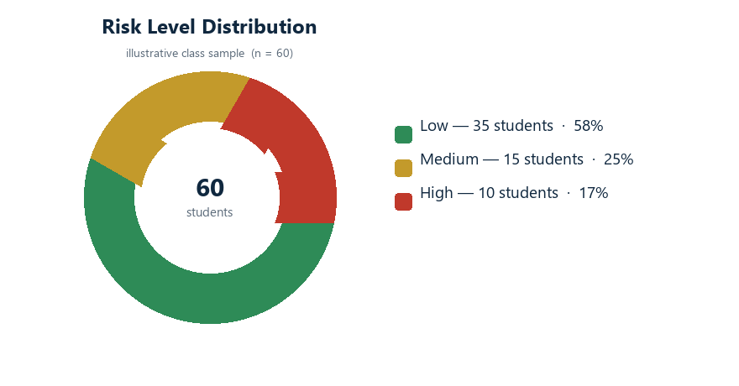
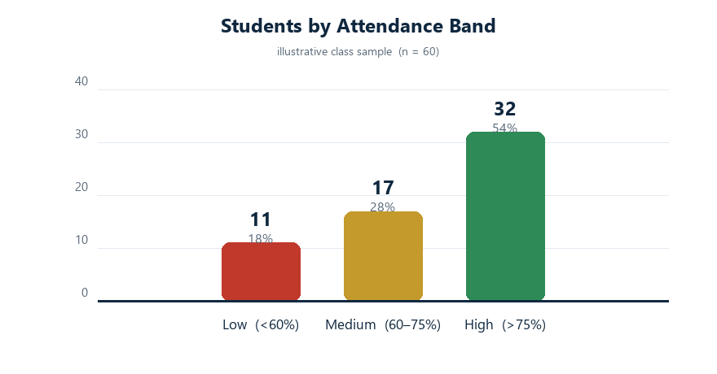
SECTION 12 · EXPECTED
Expected Outcomes
Expected results, followed by illustrative analytics from the system pipeline
▪ Prediction — Accurate mark prediction and early risk flagging — explainable to faculty and parents.
▪ Functionality — Complete role-aware web app with finance, certificates, projects, reports and alerts.
▪ Performance — Fast responses via caching; reports generated in seconds; growing automated tests.
SUCCESS CRITERIA
▪ Early-warning before results decline
▪ Zero manual reporting — exports by click
▪ Explainability on every prediction
▪ SQLite → MySQL-ready via SQLAlchemy
ILLUSTRATIVE SAMPLE ANALYTICS
Class-sample scenario (n = 60) computed with the exact prediction + risk pipeline
AI-Powered Student Management System · Minor Project Evaluation
14 / 17

Slide 15
SECTION 13 · CONCLUSION
Conclusion & Future Work
Current status of the project and planned next steps
▪ Current status — A working full-stack prototype covering the complete student lifecycle — finance, certificates, projects and analytics — with an explainable AI layer and Docker deployment.
▪ Key achievement — One platform that records data, predicts outcomes and drives early action — beyond a conventional ERP or LMS.
▪ Individual contribution — Each team member can demonstrate their module: API/auth, AI model & explain, dashboards/reports, and frontend portals.
PLANNED IMPROVEMENTS
▪ LLM-powered AI assistant (replace canned responses)
▪ Email / SMS alerts and parent digest summaries
▪ Cloud deployment — MySQL, Docker Compose to cloud
▪ Mobile / responsive apps and accessibility
▪ GPA and dropout-risk prediction, topic analytics
▪ Automated attendance capture integration
AI-Powered Student Management System · Minor Project Evaluation
15 / 17

Slide 16
SECTION 14 · REFERENCES
References
Documentation and resources consulted during the project
▪ Documentation — Flask — flask.palletsprojects.com
▪ Documentation — SQLAlchemy ORM — docs.sqlalchemy.org
▪ Documentation — scikit-learn Ensemble Methods (Random Forest) — scikit-learn.org
▪ Documentation — PyJWT — pyjwt.readthedocs.io | JWT RFC 7519
▪ Documentation — ReportLab (PDF) — reportlab.com | OpenPyXL — openpyxl.readthedocs.io
▪ Web — Python 3 — docs.python.org | Mozilla MDN (HTML / CSS / JS)
▪ Project — Internal API reference — backend/API_DOCS.md, contributing guide, source code
RESEARCH CONTEXT
▪ Predicting student performance from attendance and study behaviour (supervised regression / classification studies).
▪ Explainable machine learning for per-student feature impact.
Full citation list to be included in the project report.
AI-Powered Student Management System · Minor Project Evaluation
16 / 17

Slide 17
Thank You
Questions & Discussion
Gaurav Ranpeeshiya · Khushbu Raout — B.Tech (IT)
Enr. BTIT24O1055 · BTIT241069 — Madhav Institute of Technology and Science, Gwalior · Deemed University
AI-Powered Student Management System — Minor Project Evaluation · 2026

